Slide 1
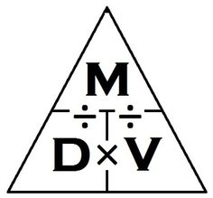
List of forces:
Gravity
Magnetism
Pull
Push
Drag
Friction
Water Resistance
Air Resistance
Upthrust
Weight
Thrust
Electromagnetism
Weight and Mass
Weight and Mass are not the same. Weight is the force acing upon an object, and weight is how much matter is in an object.
We use forces in every day life. Examples are a push or a pull.
Density=Mass ÷ Volume
Mass=Density × Volume
Volume=Mass ÷ Density

